Slide 1
Tested Forecasting Methods
Non-Trend Based Methods
Trend Based Methods
Moving Average (MA)
Weighted Moving Average (WMA)
Exponential Smoothening (ES)
Exponential Smoothening w/ Trend (EST)
Moving Window Linear Regression
Moving Window 2nd Order Regression
Performance Metrics:
Mean Absolute Deviation (MAD)
Tracking Signal (TS)
Parameters:
Window = [3 5 9 11 20]
α Value = [0.2 0.4 0.6 .8]
d Value = 0.5
Name: Donthi Reddy, Sai Narsi Reddy ID: 16186610

Slide 2
Results on 'kc-pd-sql01'
Method | Window | α value | MAD | TS
Moving Average | 20 | - | 207.21 | -11.14
Weighted Moving Average | 20 | - | 177.61 | -3.19
Exponential Smoothing | - | 0.8 | 75.11 | -19.75
Exponential Smoothing w/ Trend | - | 0.8 | 98.42 | 0.04
Moving Window Linear Regression | 5 | - | 112.45 | -3.91
Moving Window 2nd order Regression | 11 | - | 153.50 | 0.63
In all the tested VM’s:
Exponential Smoothing w/ Trend performed better on all VM’s.
Moving Average is the least performing forecasting technique.

Slide 3
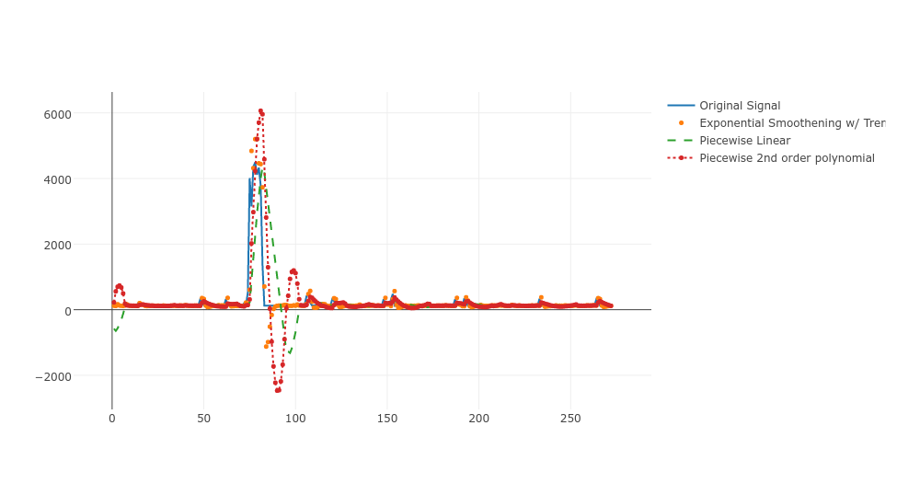
A problem with trend methods

